Slide 1
Introduction to C#
Raghu Prasad Konandur
SME

Slide 2
Introduction
Raghu Prasad – BE, MS
Total of 27 years of experience
7 years as a lecturer in an Engineering College
20 Years into IT
Worked with companies like CISCO,CSC,ICICI,First Apex – NTT Data
Currently into Corporate training and consultancy
Worked with corporates and public sector
Service Offerings – In person/On-line/Corporate/Academic Institutes
Consultancy – Consultant to vendor of Atal Tinkering Lab/ECIL-ECIT, Incarnus – Healthcare Service Provider, Automation Spectrum Pty Ltd,Australia,Tech Varaha,Bengaluru
Technologies – Java,Python,C#,.Net,Web technologies,Java Script technologies (MEAN stack),IOT,Test Automation,Machine Learning,Artificial Intelligence,Blockchain and ERP
Corporate Customers – iLink,Sony,IQVIA,ITC Infotech,Philips,L & T,NextGen,Incarnus,Aspire system,Netwoven,SkillUpRight
Academic Customers - BGS-IT,Sindhi College,Malnad Enginering College,S B College of Management, REVA University,Nagarjuna Engineering College,Dayanand Sagar University,Acharya Institute of Technology,NIE Mysore,NIT-Imphal, AMC College, Kristu Jayanti College,SIT Tumakuru,etc

Slide 3
Topics
Delegates
Anonymous Functions
Lamdba Functions
Events

Slide 4
Delegates
Delegate meaning from google: a person sent or authorized to represent others, in particular an elected representative sent to a conference.
Delegate is a type which holds a method’s reference in an object.
It is also called function pointer.
Delegate is of reference type.
Delegate signature should be as same as the method signature referencing by a delegate.
Delegate can point to a parameterized method or non-paramterized method.
Delegate has no implementation means no body with { }.
We can use invoke() method with delegates.
Delegates are used to encapsulate methods.

Slide 5
Delegates
In the .Net framework, a delegate points to one or more methods. Once you instantiate the delegate, the corresponding methods invoke.
Delegates are objects that contain references to methods that need to be invoked instead of containing the actual method names
Using delegates, you can call any method, which is identified only at run-time.
A delegate is like having a general method name that points to various methods at different times and invokes the required method at run-time.
In c#, invoking a delegate will execute the referenced method at run-time.

Slide 6
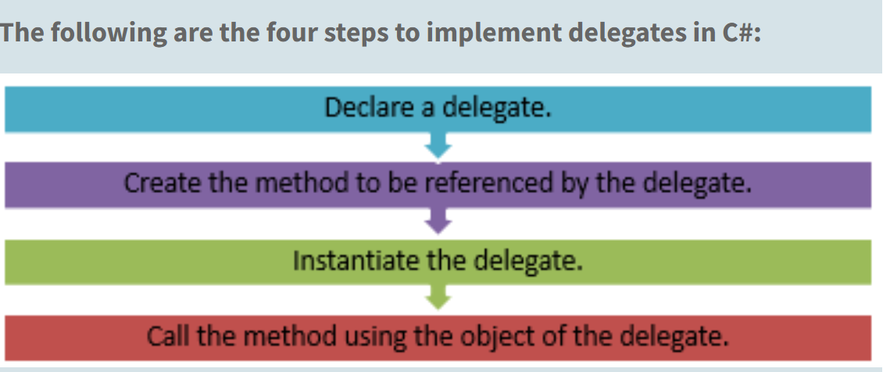
Delegates

Slide 7
Delegates
The following syntax is used to declare a delegate:
<access_modifier> delegate <return_type> DelegateName([list_of_parameters]);
where,
access_modifier: Specifies the scope of access for the delegate. If declared outside the class, the scope will always be public.
return_type: Specifies the data type of the value that is returned by the method.
DelegateName: Specifies the name of the delegate.
list_of_parameters: Specifies the data types and names of parameters to be passed to the method.

Slide 8
Delegates
The following code declares the delegate Calculation with the return type and the parameter types as integer:
public delegate int Calculation(int numOne, int numTwo);
Instantiating Delegates
The next step after declaring the delegate is to instantiate the delegate and associate it with the required method by creating an object of the delegate.
Like all other objects, an object of a delegate is created using the new keyword.
This object takes the name of the method as a parameter and this method has a signature similar to that of the delegate.
The created object is used to invoke the associated method at run-time.

Slide 9
Delegates
The following syntax is used to instantiate a delegate:
<DelegateName><objName> = new <DelegateName>(<MethodName>);
where,
DelegateName: Specifies the name of the delegate.
objName: Specifies the name of the delegate object.
MethodName: Specifies the name of the method to be referenced by the delegate object.

Slide 10
Delegates
The following code declares a delegate Calculation outside the class Mathematics and instantiates it in the class:
public delegate int Calculation (int numOne, int numTwo);
class Mathematics
{
static int Addition(int numOne, int numTwo)
{
return (numOne + numTwo);
}
}

Slide 11
Delegates
static void Main(string[] args)
{
int valOne = 5;
int valTwo = 23;
Calculation objCalculation = new Calculation(Addition);
Console.WriteLine (valOne + “ + “ + valTwo + “ = “ +
objCalculation (valOne, valTwo));
}

Slide 12
Delegates
Reference :
https://learningneverendstech.com/2021/12/17/delegates-types-of-delegates-in-c/

Slide 13
Thank You
Raghu Prasad Konandur
9845547471

